Slide 1

Travel Data Analysis report
Mohammad Tippu Sohail
Mohammad Salman

Slide 2
objectives
Uncover actionable insights through comprehensive data analysis of Airbnb usage patterns, guest preferences, and market trends to enhance strategic decision-making, optimize user experiences, and drive sustainable business growth.

Slide 3
Benefits
Smart Strategy: Use data for sharp decision-making and effective business strategies.
Market Agility: Stay ahead by adapting to trends and optimizing in real-time.
Sustainable Growth: Expand business through targeted, data-driven initiatives.
Efficiency Boost: Optimize processes and resources for maximum impact.
Loyal Relationships: Build lasting connections with services aligned to guest expectations.
Profit Precision: Fine-tune pricing and marketing for increased profitability.
Innovate Continuously: Foster ongoing innovation through data-driven insights.
Lead the Industry: Maintain a pioneering role by leveraging data for new opportunities.

Slide 4
Problem definition
Identify and address key challenges in Airbnb operations through data analysis, focusing on areas such as
1. Host Analysis:
• Identifying Top Earners
• Monthly Earnings and Prices Relationship
2. Neighborhood Analysis:
• Identifying specific locations (neighborhoods) in Amsterdam that receives the maximum number of bookings
• Price and Location Relationship
3. Reviews Analysis:
• Quality and Price Relationship
• Price vs Amenities
• Price Relation with Location

Slide 5
architecture
Connect to Data in Tableau
Data Peprocessing
Connect to Data in Tableau
Data Peprocessing
Exploratory Data Analysis
Exploratory Data Analysis
Feature Engineering
Feature Engineering
Performance Optimization
Implement Calculations and Expressions
Implement Calculations and Expressions
Design and Create Worksheets
Documentation
Deployment

Slide 6
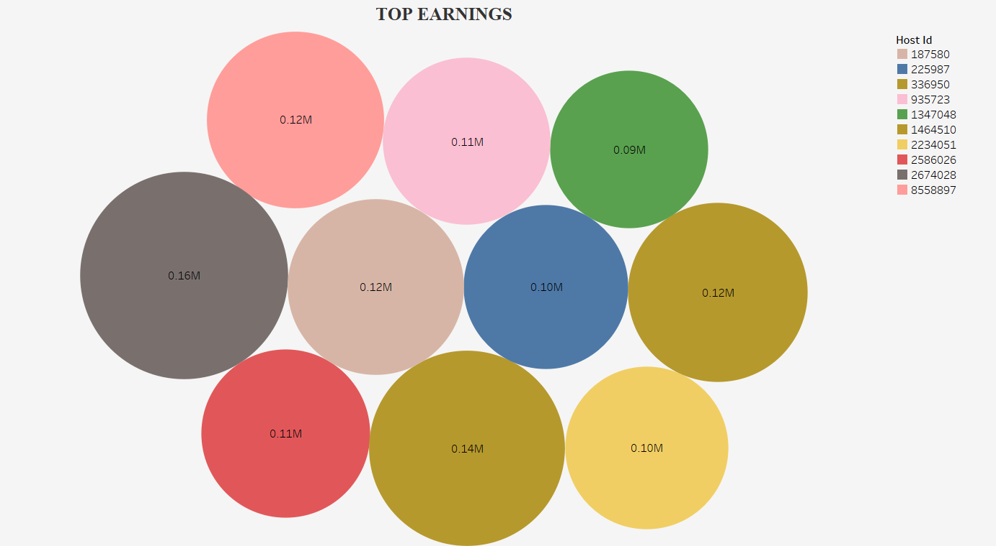
TOP EARNERS with respect to HOST id
The Top 5 Hosts who manages the property listings and earned the most among all the hosts are as follows:
Host ID 2674028: Earned mostly from Oud Noord from Home/Apt type with 0.16M euros.
Host ID 336950: Earned Mostly from Centrum West, from private room type with total Earnings 0.14M euros.
Host ID 187580: Earned Mostly from centrum west specifically from Private Room type with total Earnings 0.12M euros.
Host ID 1464510: Earned mostly from Various Neighborhoods, specifically from Home/Apt type with total Earnings 0.12M euros.
Host ID 8558897: Earned mostly from Centrum Oost, Noord-West/Noord-Midden,speicifically from entire Home/Apt type with total Earnings 0.12M euros.

Slide 7
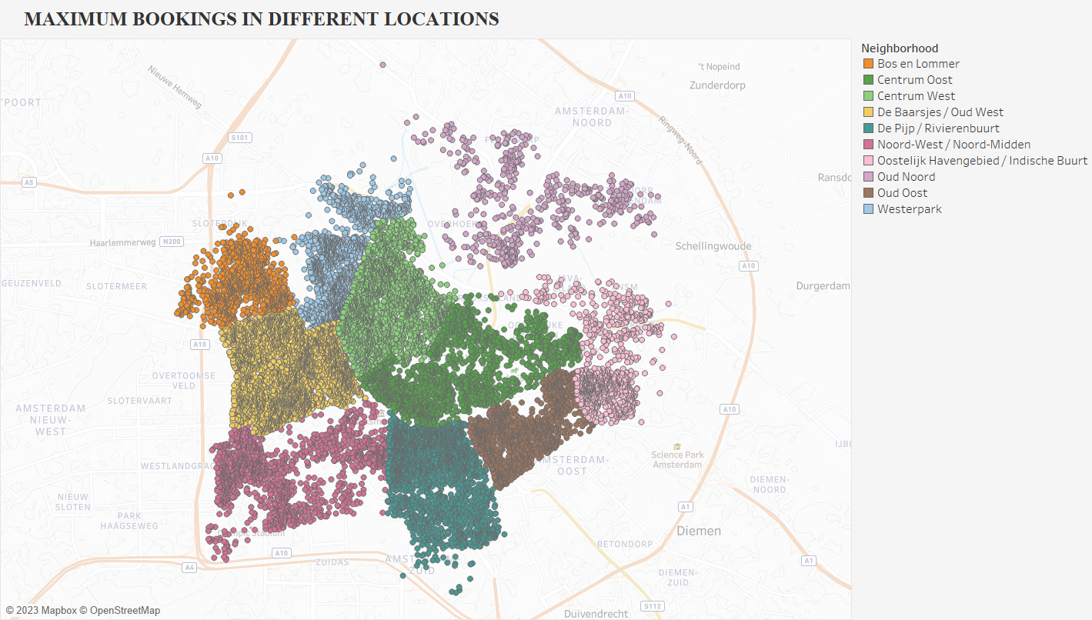
MAXIMUM BOOKINGS AMONG DIFFERENT LOCATIONS :
The Top 5 Neighborhoods with Max Bookings based on their total reviews are as follows :
De Baarsjes / Oud West with a total no of bookings of 52823.
Centrum west with a total no of bookings of 52115.
Centrum Oost with a total no of bookings of 37221.
De Pijp / Rivierenbuurt with a total no of bookings of 35627.
Noord-West / Noord-Midden with a total no of bookingsvof 19097.

Slide 8
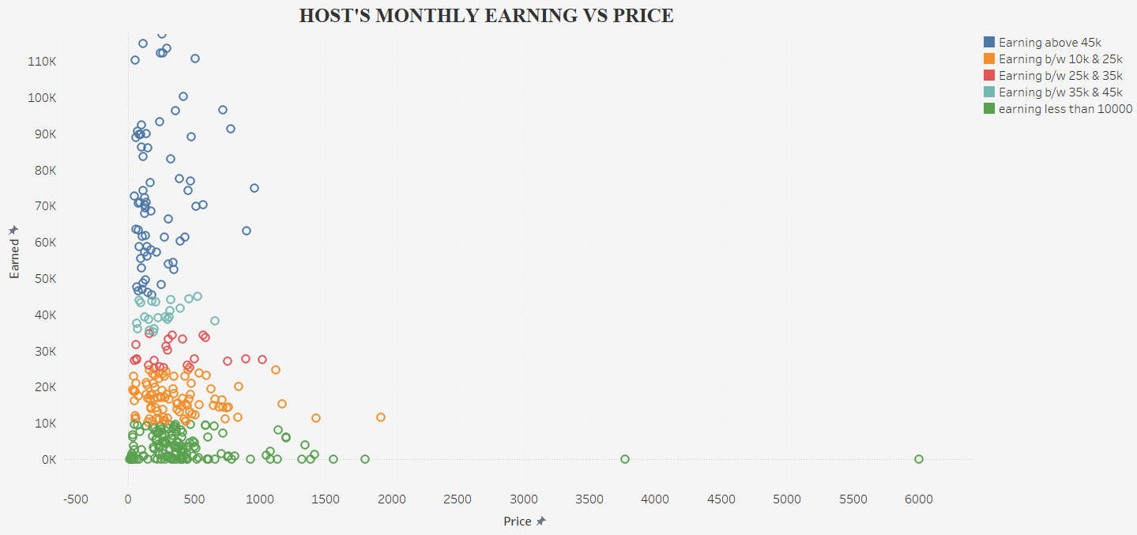
HOSTS MONTHLY EARNING VS PRICE:
Because of significant increase in the pricing of hotels there is nothing much improved in the earning of host . But when pricing is below 1000 euros the host revenued been increased significantly.
For example, in Westerpark for a pricing of 6000 euros the host earns almost nothing.
But in centrum west, even for a pricing around 180 euros, host earns significantly.

Slide 9
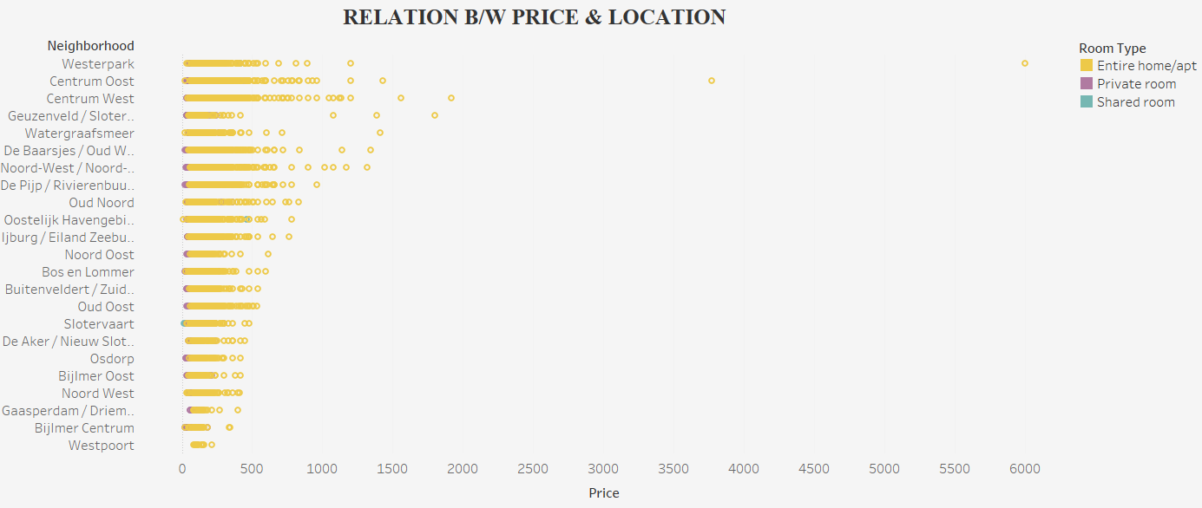
RELATION BETWEEN PRICE AND LOCATION :
Extreme prices where observed in Westerpark & Centrum Oost: 6000 euros and 3800 euros. Also, Most prices were below 800 euros. Only entire home/apartments show a wide pricing range.
Private room prices mostly below 300 euroseverywhere.Geuzenveld/Slotermeer offers 172 euros minimum and 480 euros maximum.
Shared room prices generally below 200 euros. And Geuzenveld/Slotermeer, Bijlmer Centrum offer under 50 euros.Westerpark has the highest, reaching up to 400 euros.

Slide 10
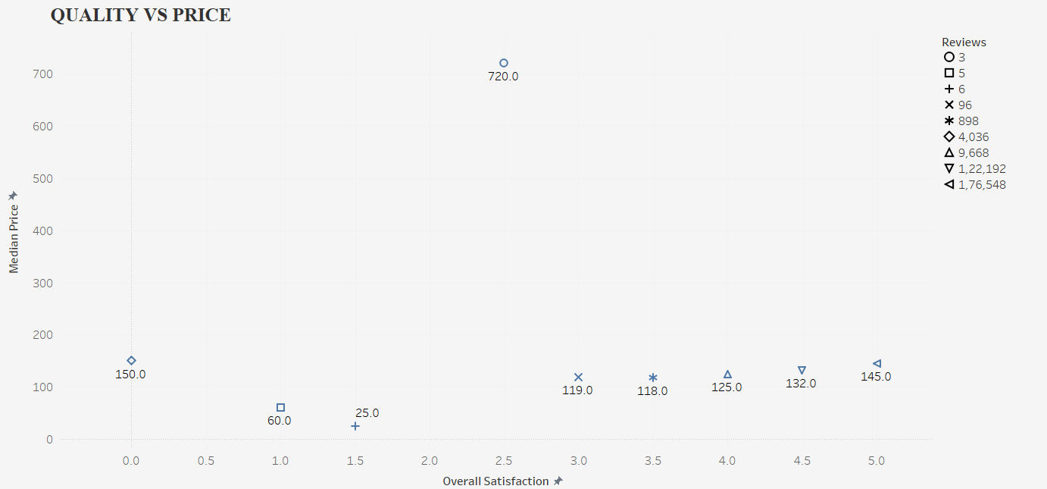
RELATION BETWEEN QUALITY VS PRICE:
Some of worst performing hotels are as
In Slotervaart, hotel named ‘Iam easy quest-easy to sleep’ has a median price of 25 & rating of 1.5.
In De Baarsjes / Oud West, hotel named ‘Amsterdam C. during Christmas’ has median price of 60 & rating of 1.0 and
Also, there are some hotels even though charging an median price of 150 euros stills got the worst rating with almost 0.0.
Where as some hotels whose median prices falls between 125 to 145 has still got rating over 4.0. In centrum west, hotel named ‘old church red light bed’ charging an median price of 720 euros gets an rating of 3.

Slide 11
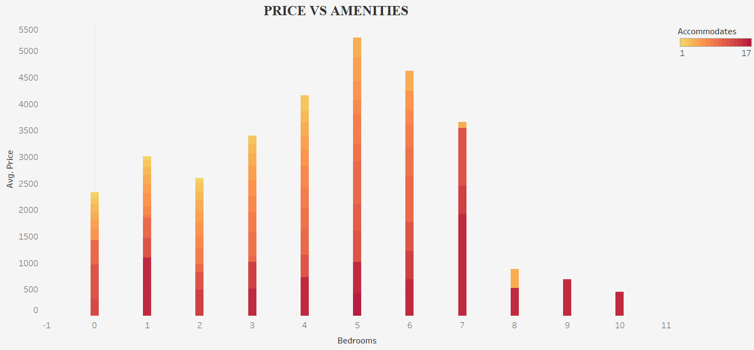
RELATION BETWEEN PRICE VS AMENITIES:
Generally, more bedrooms mean higher rent due to increased space for guests.
Prices don't consistently increase with bedrooms, Factors like location, amenities, or overall condition contribute to this variation.
The relationship between bedrooms and price is not strictly linear.

Slide 12
conclusion
The results will help stakeholders in the Airbnb ecosystem, including hosts and travelers, make informed decisions for a more personalized and enjoyable experience.

